Slide 1

ONLINE SURVEY SYSTEM

Slide 2
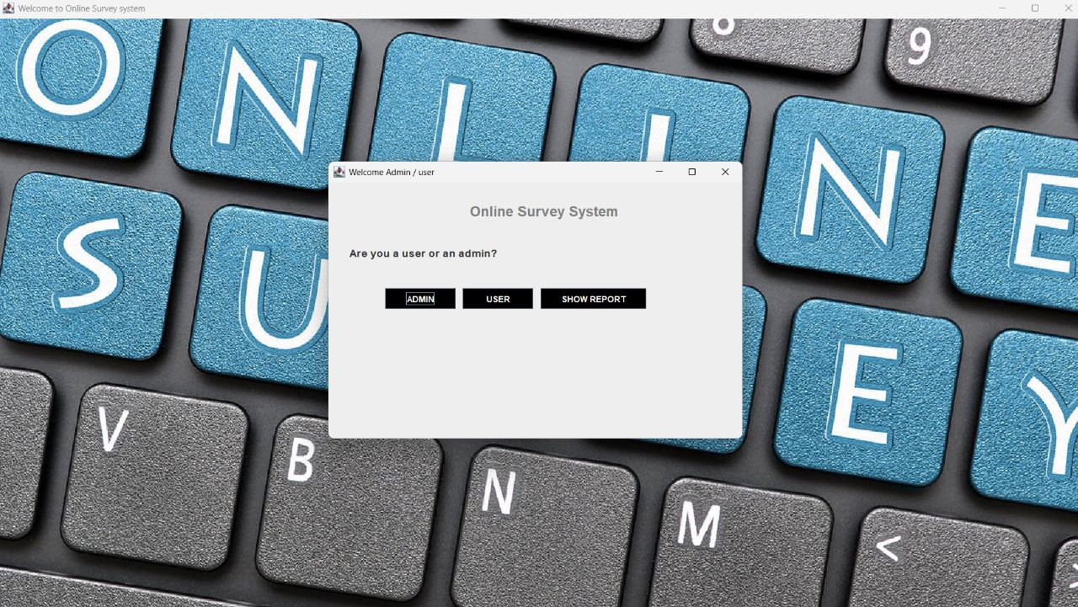
ONLINE SURVEY SYSTEM

Slide 3
The Admin side of our online survey system is where you can manage all aspects of your survey, from creating new surveys to viewing responses.
The admin side provides detailed analytics and reports that allow you to track responses according to the queries.
ONLINE SURVEY SYSTEM
ADMIN SIDE

Slide 4
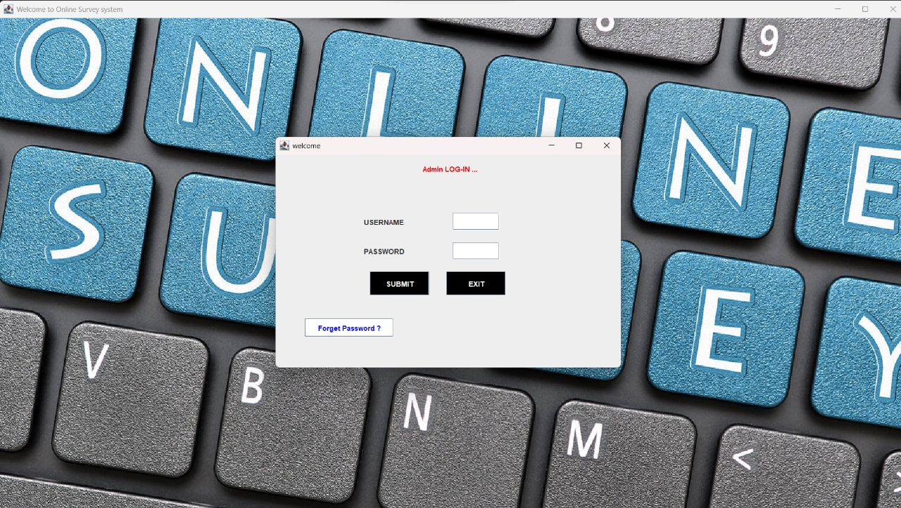
ADMIN SIDE
The Admin side of our online survey system is where you can manage all aspects of your survey, from creating new surveys to viewing responses.
The admin side provides detailed analytics and reports that allow you to track responses according to the queries.
ONLINE SURVEY SYSTEM

Slide 5
ONLINE SURVEY SYSTEM
The Admin side of our online survey system is where you can manage all aspects of your survey, from creating new surveys to viewing responses.
The admin side provides detailed analytics and reports that allow you to track responses according to the queries.
ADMIN SIDE

Slide 6
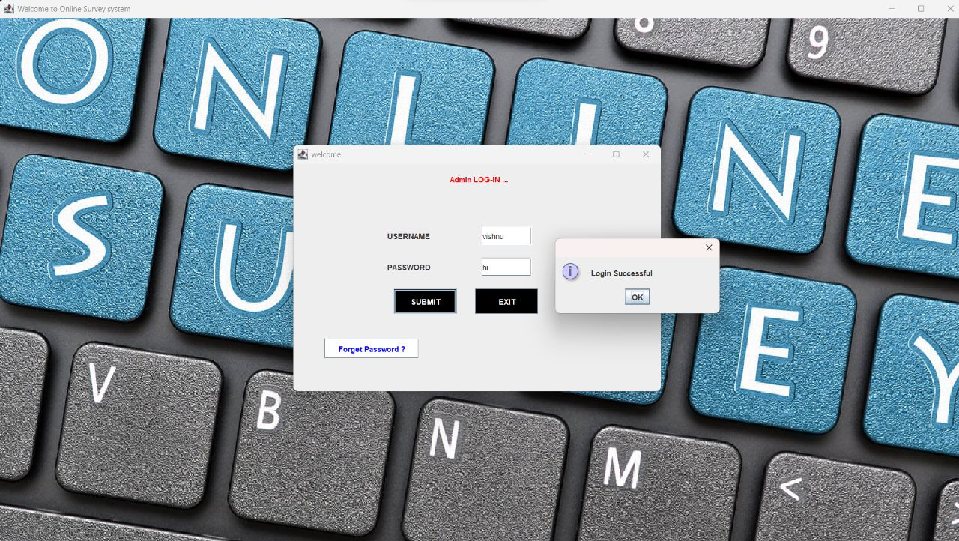

Slide 7
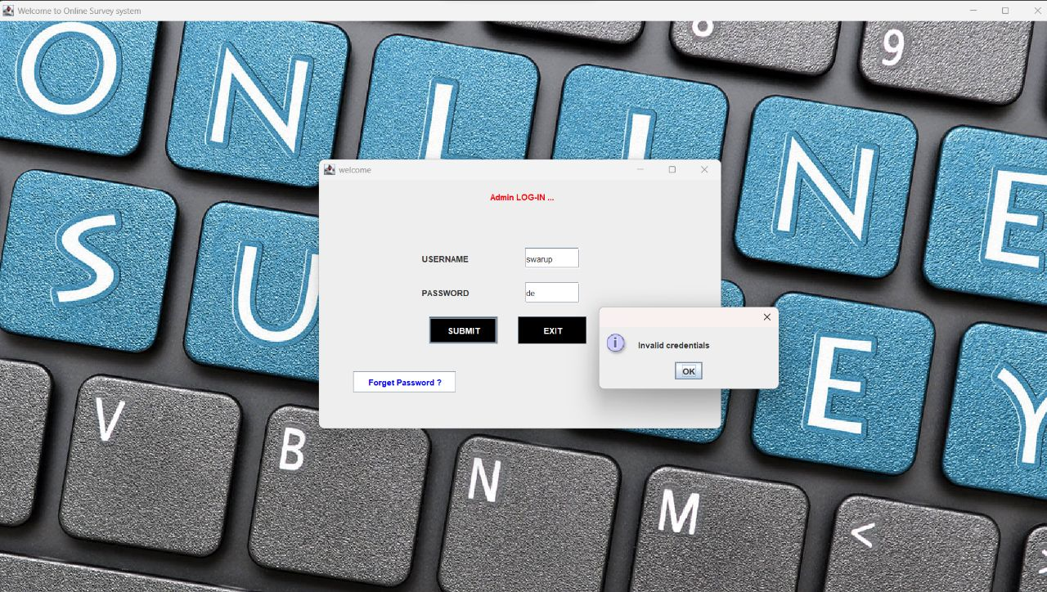

Slide 8
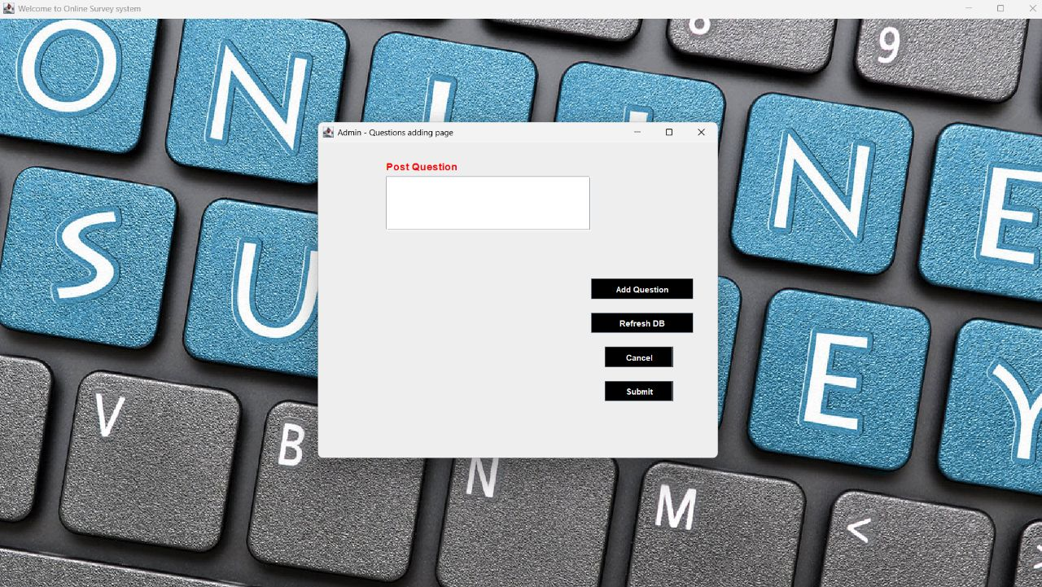

Slide 9
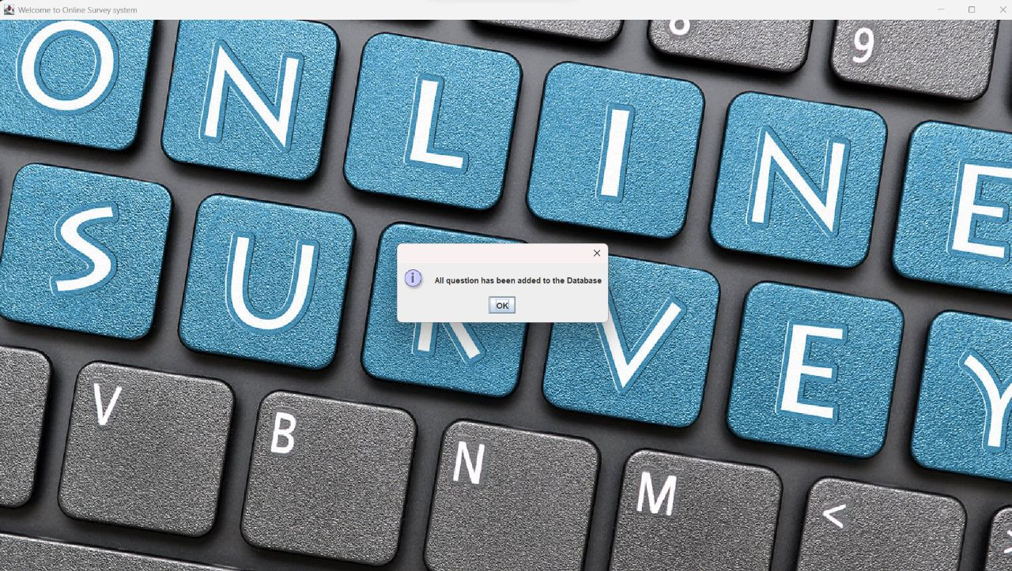

Slide 10
The user side of the online survey system is designed to make it easy for respondents to take surveys. It has a simple interface which can be easily understood by the user and give survey.
One of the key features of the user side is the ability for respondents to review their response.
USER SIDE

Slide 11
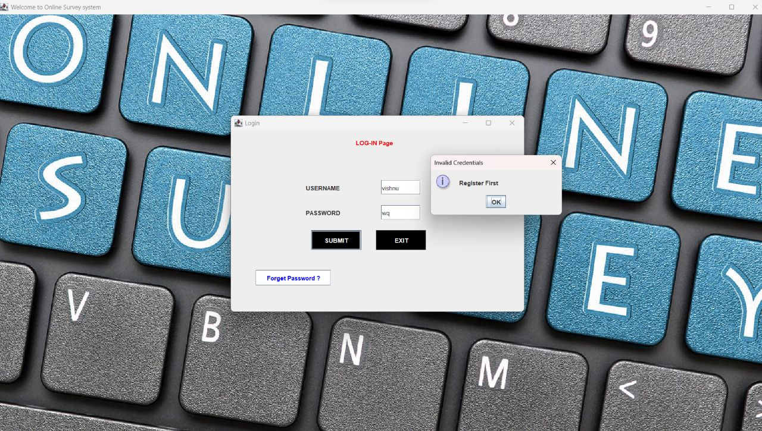
USER SIDE
The user side of the online survey system is designed to make it easy for respondents to take surveys. It has a simple interface which can be easily understood by the user and give survey.
One of the key features of the user side is the ability for respondents to review their response.

Slide 12
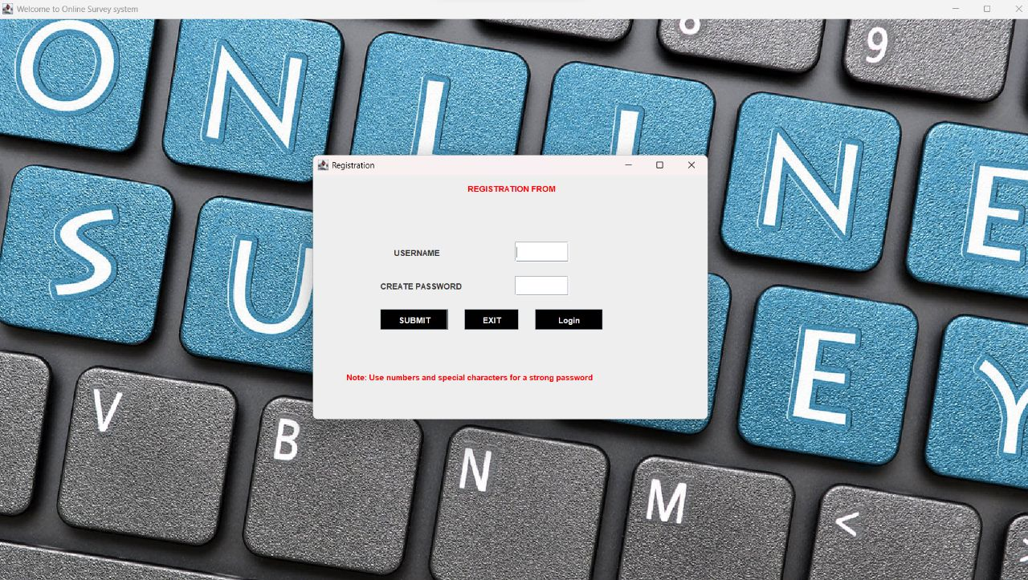
USER SIDE
The user side of the online survey system is designed to make it easy for respondents to take surveys. It has a simple interface which can be easily understood by the user and give survey.
One of the key features of the user side is the ability for respondents to review their response.

Slide 14
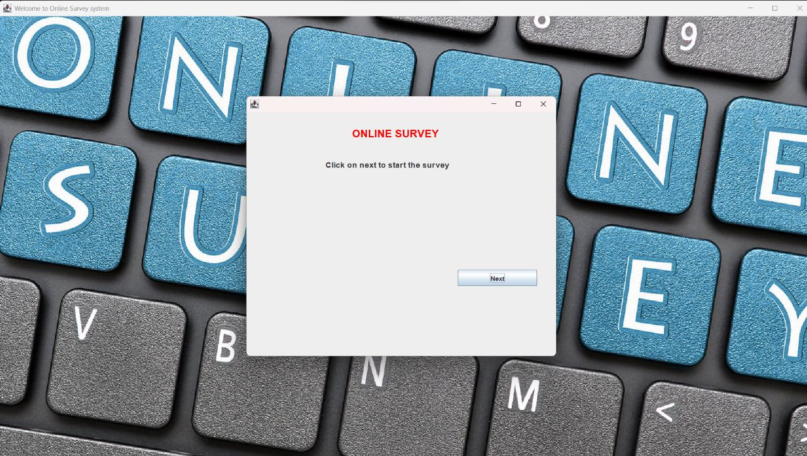
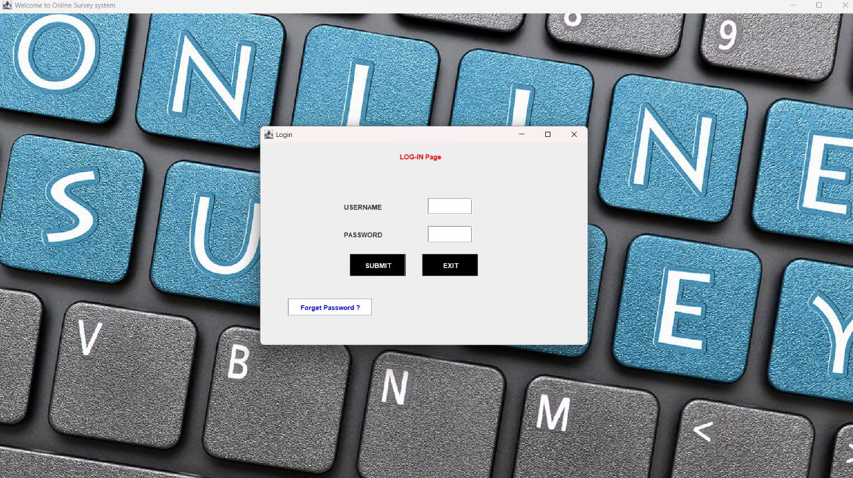

Slide 16
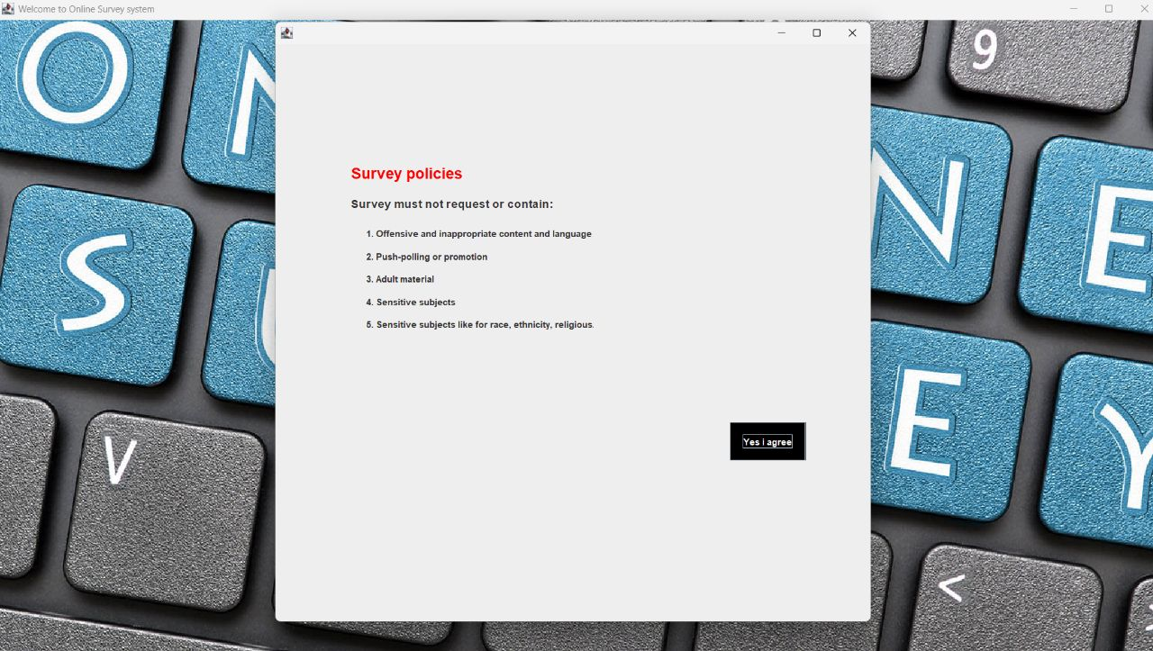

Slide 17
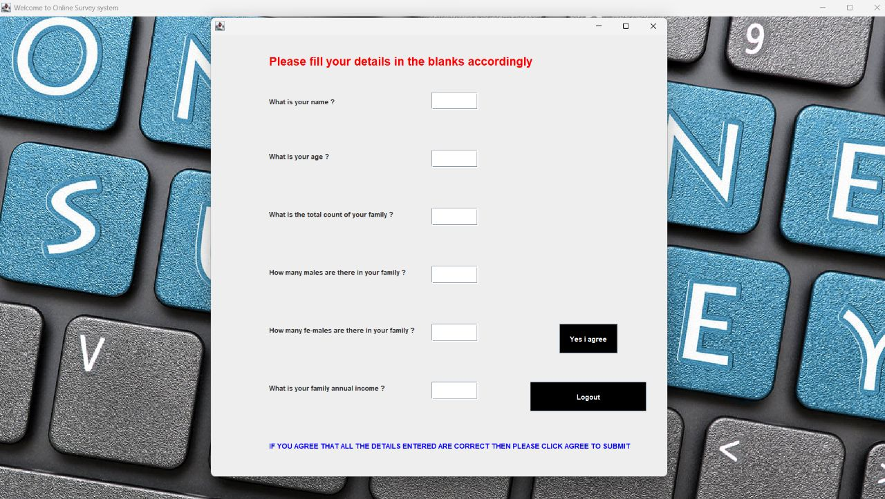
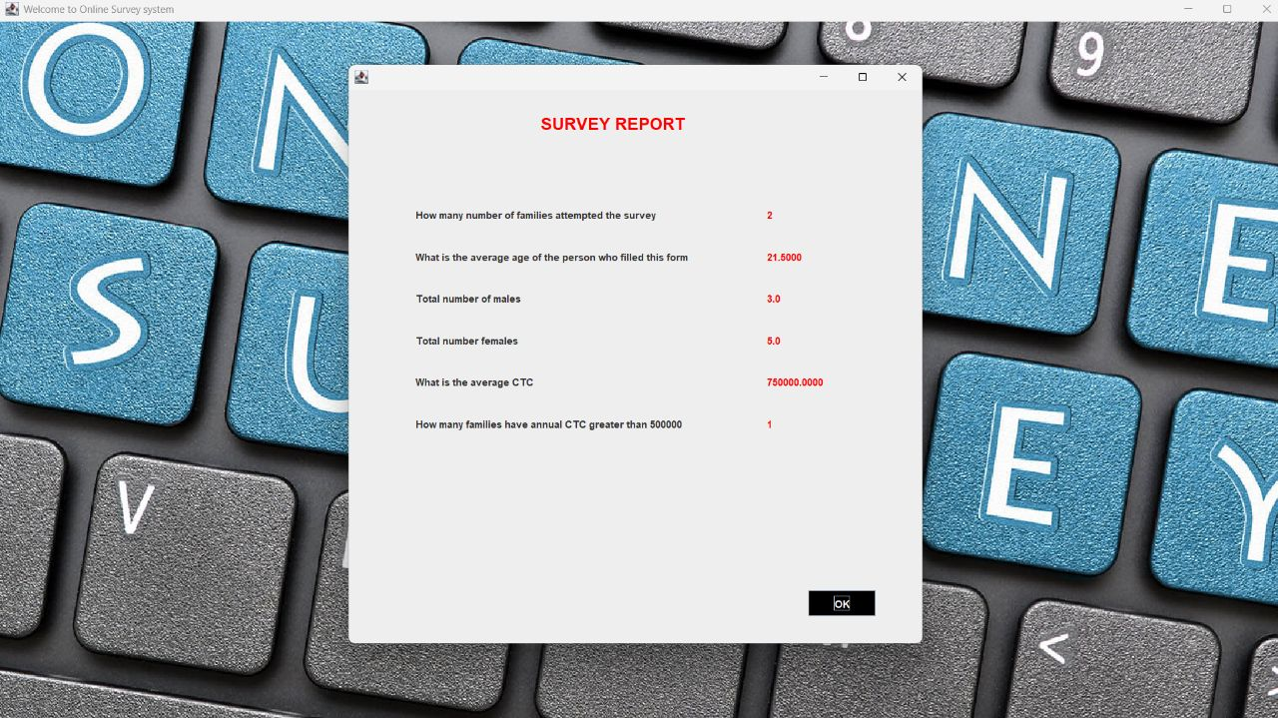

Slide 19
THANK YOU

